Slide 1
CAPSTONE PROJECT RESTAURANT REVENUE PREDICTION
PRESENTED BY
NAME : MADESH K
REG NO : 950921105004
DEPARTMENT : ELECTRICAL AND ELECTRONICS ENGINEERING
COLLEGE : HOLYCROSS ENGINEERING COLLEGE

Slide 2
OUTLINE
Introduction
Problem Statement
Proposed solution
Algorithm
Result
Conclusion
Reference

Slide 3
INTRODUCTION
The revenue column indicates a (transformed) revenue of the restaurant in a given year and is the target of predictive analysis. In this project, I first download and explore the dataset. Then I prepare the dataset for training by splitting the data into train. ing and validation sets

Slide 4
Problem statement
The objective of this project is to develop a robust revenue prediction model for a restaurant that can forecast future revenue with a high degree of accuracy. The model should take into account both internal and external factors influencing revenue generation, including historical sales data, menu popularity, customer demographics, promotional activities, weather conditions, and economic indicators.

Slide 5
PROPOSED SOLUTION
The solution will involve several key steps:
Data Collection and Integration:
Gather historical sales data, including daily and monthly revenue figures.
Collect data on menu items, their prices, popularity, and seasonal variation.
Obtain information on customer demographics, such as age, gender
Data Preprocessing:
Cleanse the data to handle missing values, outliers, and inconsistencies.
Perform feature engineering to extract relevant features such as day of the week, month, seasonality indicators, and holidays.

Slide 6
Model Selection and Training:
Explore various regression models such as linear regression, decision trees, random forests, gradient boosting, and neural networks.
Split the dataset into training and validation sets using techniques like time-based splitting to preserve temporal relationships.
Ensemble and Stacking:
Experiment with ensemble methods such as bagging, boosting, and stacking to combine multiple models for improved predictive accuracy.
Employ techniques like model averaging or weighted averaging to blend predictions from different models.
Model Deployment and Monitoring:
Deploy the trained model into a production environment, either as a standalone application or integrated within the restaurant's existing systems.
Implement monitoring mechanisms to track model performance and detect drift, ensuring that predictions remain accurate over time.

Slide 7
algorithm
Creates an example DataFrame with dates and revenue data.
Converts the 'date' column to datetime type.
Extracts features for training the model (for demonstration, we only use the numerical representation of the day of the year).
Trains a simple linear regression model using the day of the year as a feature and revenue as the target variable.
Predicts revenue for future dates (next 7 days in this example).
Creates a bar plot showing actual and predicted revenue.
Displays the plot.

Slide 8
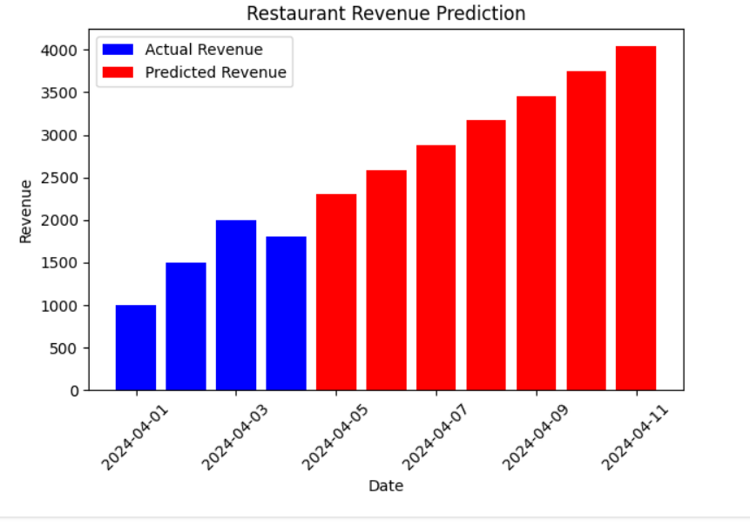
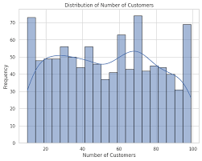
result

Slide 9
conclusion
In conclusion, the restaurant revenue prediction problem presents a significant challenge in the dynamic and competitive food service industry. Through the proposed solution, we have outlined a comprehensive approach leveraging data-driven techniques to forecast future revenue with accuracy. By following the steps outlined in the solution, restaurants can gain valuable insights into the factors influencing their revenue generation and make informed decisions to optimize operations and maximize profitability.

Slide 10
reference
I refers from https://www.Kaggle.com
Testing and output from https://www.colab.com
Scikit-learn: Machine Learning in Python. (n.d.). Retrieved from https://scikit-learn.org/stable/
TensorFlow. (n.d.). Retrieved from https://www.tensorflow.org/

Slide 11
Thank you

